Slide 1
Analog Circuits and Systems
Prof. K Radhakrishna Rao
Lecture 13:
Dynamic Behavior of Feedback Systems

Slide 2
Review
Static characteristic of negative feedback systems
Distortion reduction
Linearity
Noise reduction
Effect of saturation
Dynamic range of operation or lock range
Dynamic characteristic of feedback loop will be the topic of next lecture

Slide 3
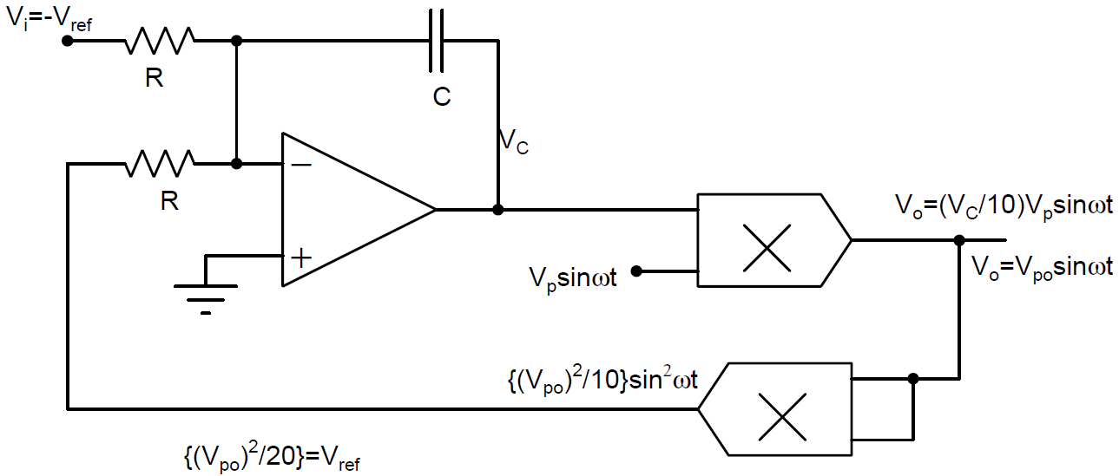
Lock Range: Automatic Gain Controller
Simulation 1: Within lock Range
Simulation 2: Outside lock Range

Slide 4
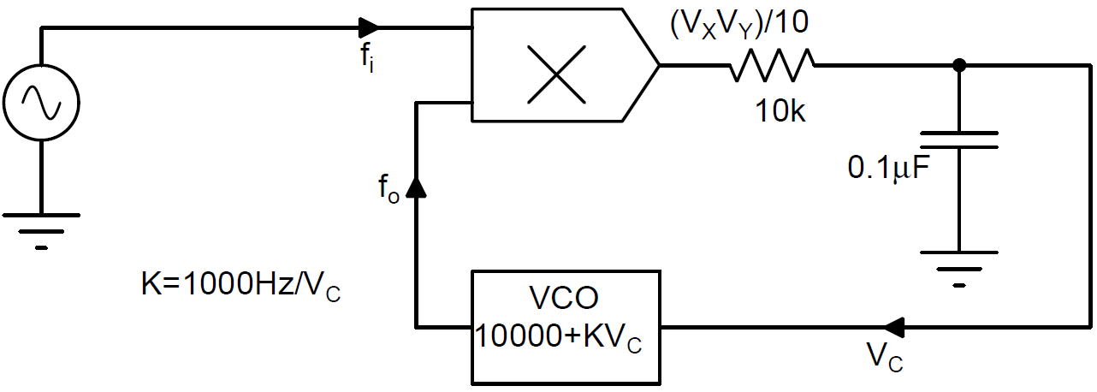
FLL – Lock Range

Slide 5
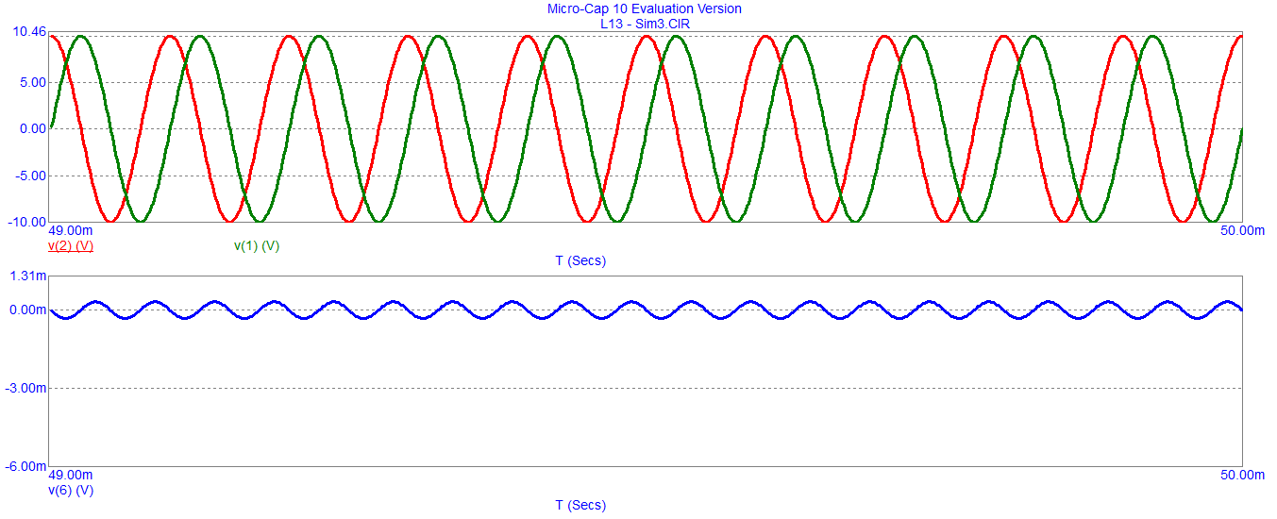
Simulation 1: Within lock Range - 10000

Slide 6
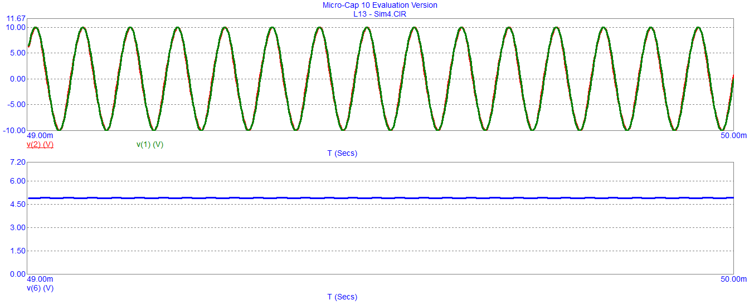
Simulation 2: Within lock Range – Upper Limit - 14900

Slide 7
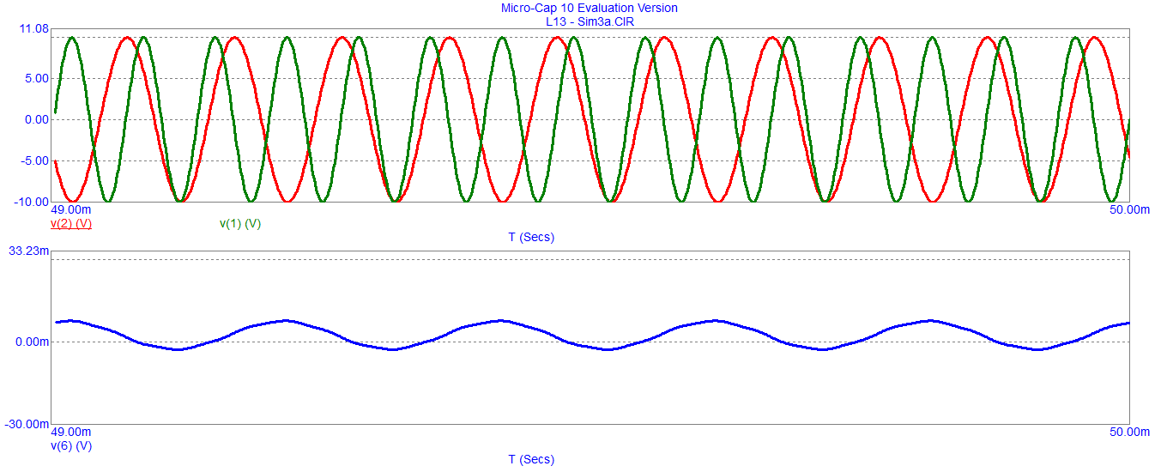
Simulation 3: Outside lock Range - 15000

Slide 8
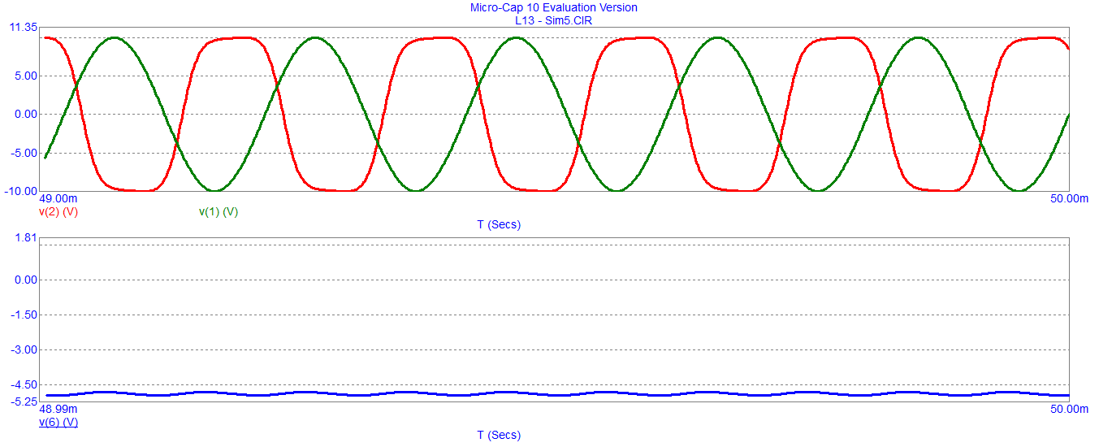
Simulation 4: Within Lock Range – Lower Limit - 5100

Slide 9
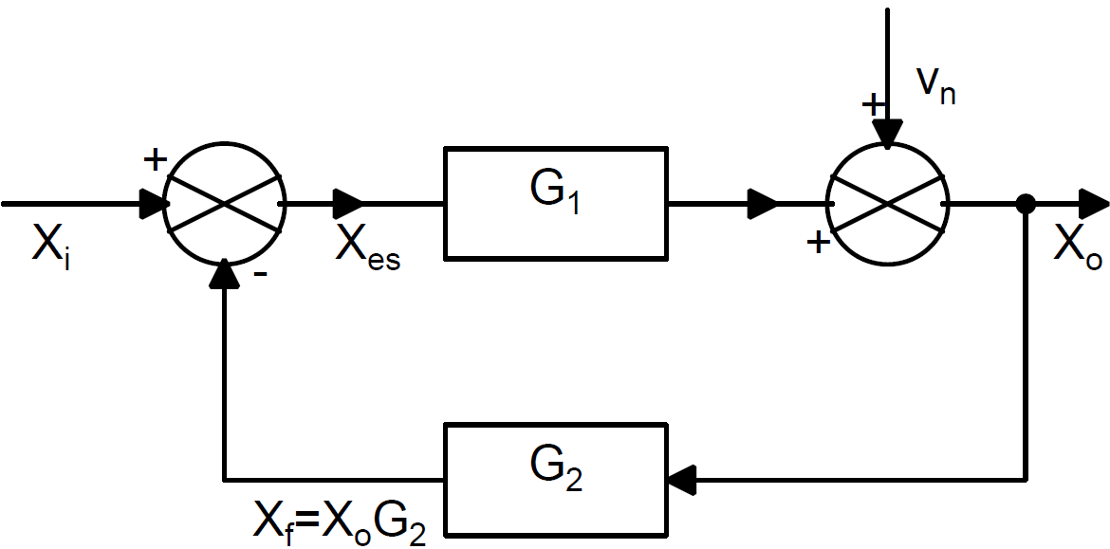
Noise, Distortion and Offset Reduction in Feedback

Slide 10
Simulation 5: Lock Range of a Current Amplifier

Slide 11
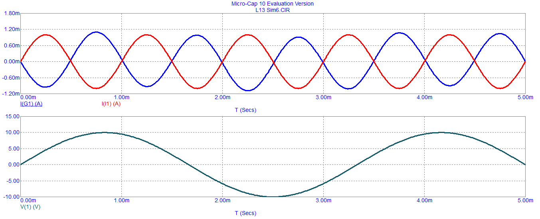
Simulation 5 (contd.,)

Slide 12
Distortion caused by non-linearity

Slide 13
Dynamic Behavior of Feedback Systems
A negative feedback system reproduces the input signal at the output in presence of noise, parameter variations, and nonlinearities.
Dynamic behavior is characterized by
Frequency dependent behavior
Time dependent behavior
Dynamics of the loop gain (G_{L}=G₁G₂) significantly influence the performance of the feedback system.

Slide 14
Linear Feedback Systems
are modeled as
Differential Equations
Laplace Transforms
Frequency dependent behavior is explored through Laplace Transforms
Feedback system is treated as a first order, second order or third order system

Slide 15
First Order System
G₂ is a constant (independent of frequency)
Where ‘s’ is the complex frequency and ω₁ is the corner frequency in radians/sec
ω₁ is known as the bandwidth of G₁

Slide 16
First Order System (contd.,)

Slide 17
First Order System: Time Response

Slide 18
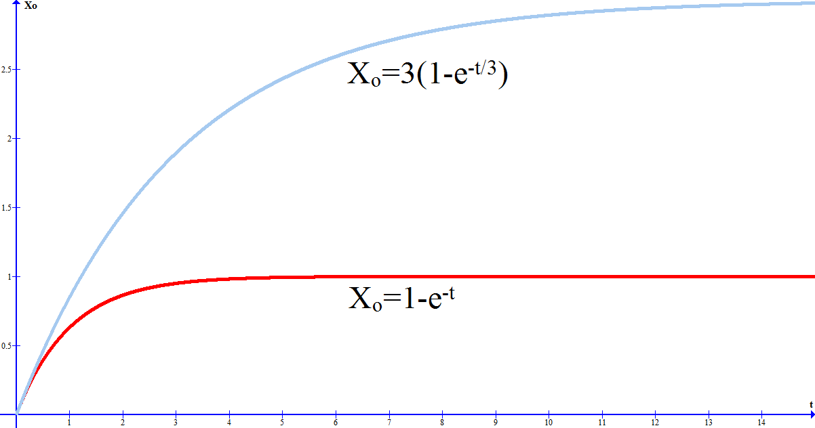
First Order System: Time Response (contd.,)
The time response for G₂ = 1/3 and 1

Slide 19
First Order System: Time Response (contd.,)
Consider the factor gain (G_{f0}) X Bandwidth (B), referred to as Gain Bandwidth product (GB). It is an important measure of the quality of the system as it determines the rate of rise of output variable and bandwidth of the feedback system.

Slide 20
First Order System: Frequency Response
Magnitude of the transfer function, G_{f}, of feedback system
For frequencies where

Slide 21
First Order System: Frequency Response (contd.,)
The phase of G_{f} is given by
For frequencies where

Slide 22
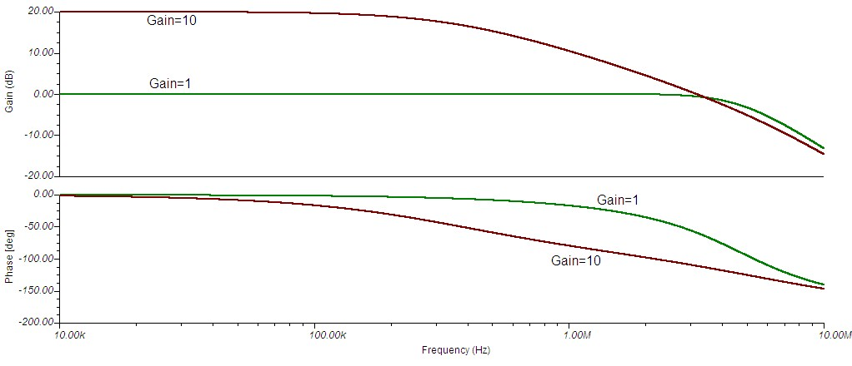
Magnitude and phase plots (Bode plots)
for and G₂ = 1/10 and 1
Phase error can be significant for frequencies greater than the
bandwidth

Slide 23
G₁- Second Order System

Slide 24
G₁- Second Order System (contd.,)

Slide 25
G₁- Second Order System (contd.,)

Slide 26
G₁- Second Order System (contd.,)

Slide 27
Second Order System: Time Response
Input – output relationship in time domain of this second order feedback system is governed by

Slide 28
Second Order System: Time Response (contd.,)

Slide 29
Second Order System: Time Response (contd.,)

Slide 30
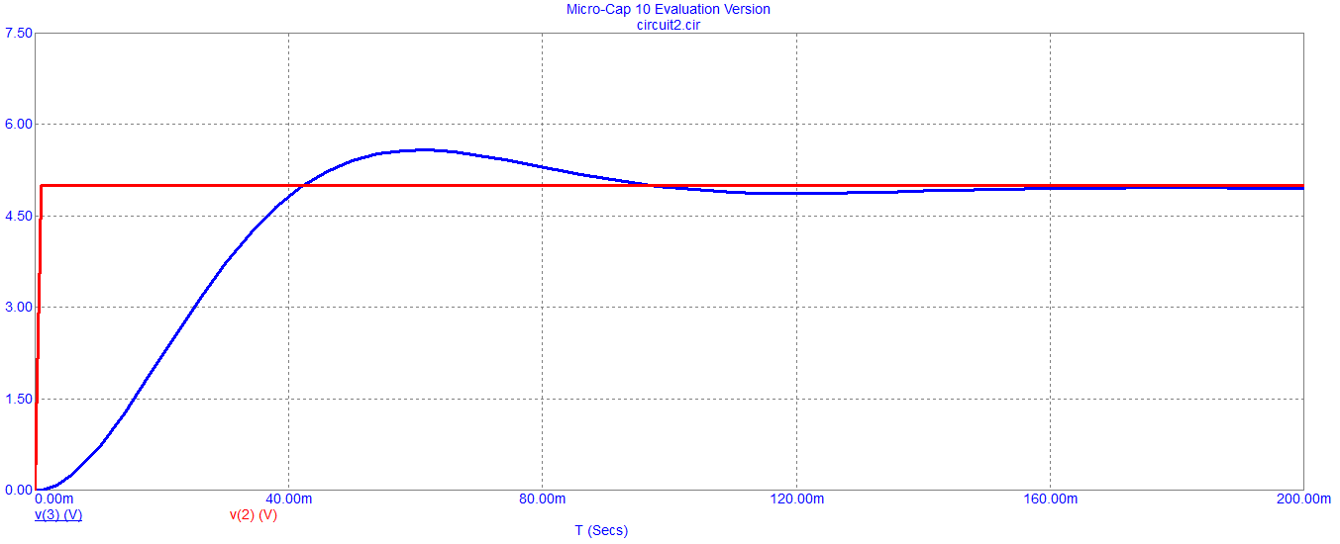
Simulation (Q=1)

Slide 31
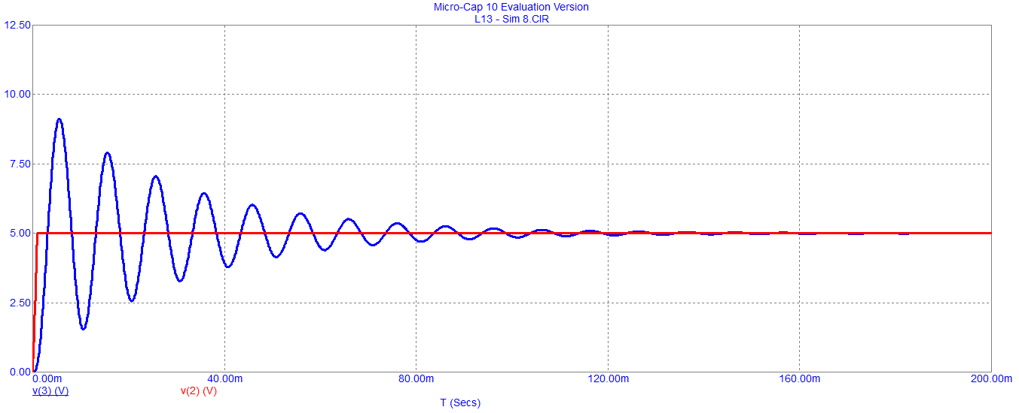
Simulation (Q=10)

Slide 32
Second Order System: Time Response (contd.,)

Slide 33
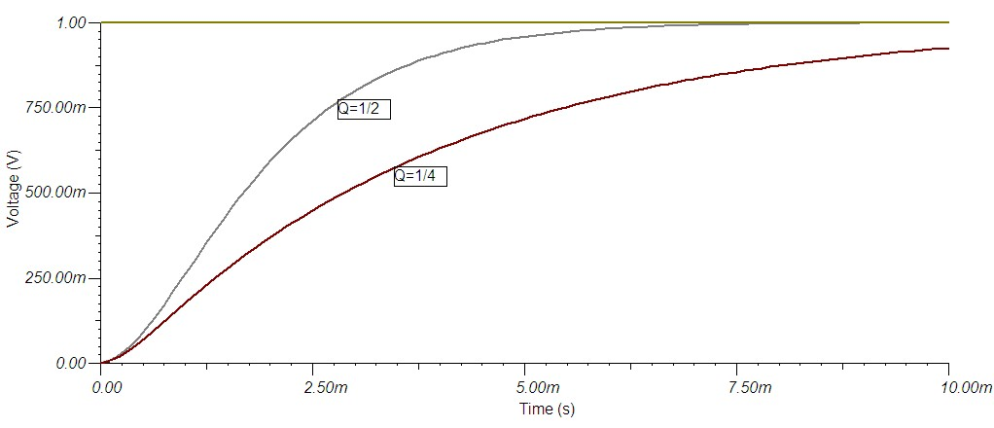
Step response of the second order system

Slide 34
Second Order System: Time Response (contd.,)
If Q<1 the rate of rise is lower.
When Q>1 the rate of rise is higher but there will be more peaks and results in higher settling time.
There are ten visible peaks (count up to 0.1 of the first peak) when Q = 10.
This can be generalized to say if Q = n, there will be n visible peaks in the transient response.
The most desirable step response of a feedback is obtained for a value of Q=1.
The response is characterized by good rate of rise with one small peak

Slide 35
Second Order System: Frequency Response

Slide 36
Conclusion

